Slide 1
Feature Engineering

Slide 2
Feature Engineering
Feature engineering means transforming raw data into a feature vector.
Feature engineering is a very important aspect of machine learning and data science and should never be ignored. The main goal of Feature engineering is to get the best results from the algorithms.
The performance of the model is depending on data preprocessing and data handling. Suppose if we build a model without Handling data, we got an accuracy of around 70%. By applying the Feature engineering on the same model there is a chance to increase the performance from 70% to more.
Simply, by using Feature Engineering we improve the performance of the model.

Slide 3
1. Feature Selection
Feature selection is nothing but a selection of required independent features. Selecting the important independent features which have more relation with the dependent feature will help to build a good model. There are some methods for feature selection:
Correlation
Variance
Chi square test
Information gain

Slide 4
1.1Correlation Matrix with Heatmap
Heatmap is a graphical representation of 2D (two-dimensional) data. Each data value represents in a matrix.
Firstly, plot the pair plot between all independent features and dependent features. It will give the relation between dependent and independent features. The relation between the independent feature and the dependent feature is less than 0.2 then choose that independent feature for building a model.

Slide 5
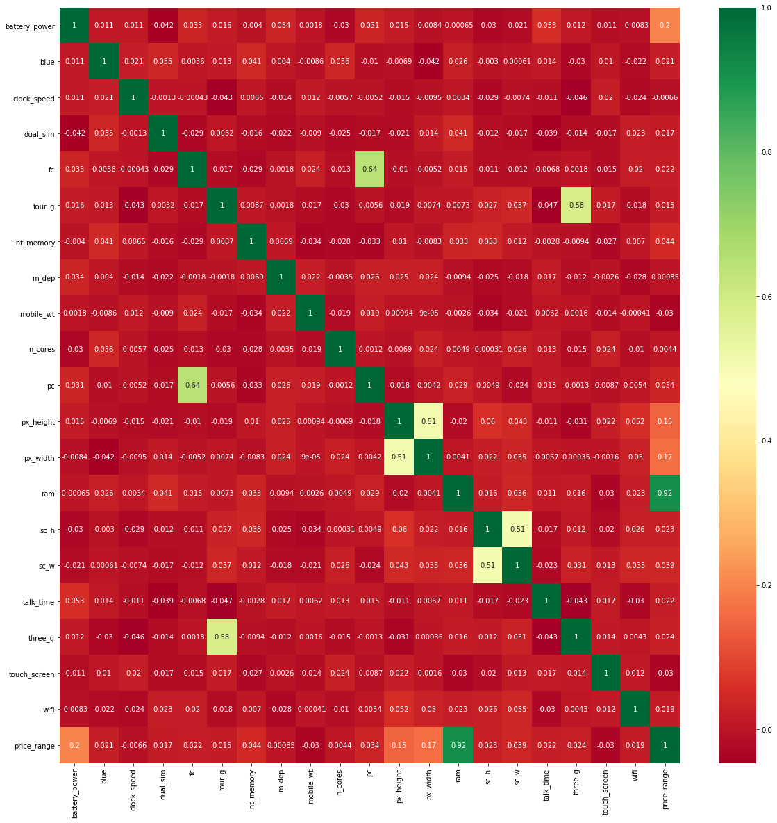
Heat map

Slide 6
Correlation
Correlation is defined as a measure of the linear relationship between two quantitative variables, like height and weight. You could also define correlation is a measure of how strongly one variable depends on another.
A high correlation is often a useful property—if two variables are highly correlated, we can predict one from the other. Therefore, we generally look for features that are highly correlated with the target, especially for linear machine learning models.
However, if two variables are highly correlated among themselves, they provide redundant information in regards to the target. Essentially, we can make an accurate prediction on the target with just one of the redundant variables.
In these cases, the second variable doesn’t add additional information, so removing it can help to reduce the dimensionality and also the added noise.
There are a number of methods to measure the correlation between variables—let’s explore the most widely used ones.

Slide 7
1.2 Univariate Selection
In this, Statistical tests can be used to select the independent features which have the strongest relationship with the dependent feature. eg,. Chi square test.

Slide 8
Chi-squared Score
This is another statistical method that’s commonly used for testing relationships between categorical variables.
Therefore, it’s suited for categorical variables and binary targets only, and the variables should be non-negative and typically boolean, frequencies, or counts.
What it does is simply compare the observed distribution between various features in the dataset and the target variable.

Slide 9
In feature selection, we aim to select the features which are highly dependent on the response.
When two features are independent, the observed count is close to the expected count, thus we will have smaller Chi-Square value. So high Chi-Square value indicates that the hypothesis of independence is incorrect. In simple words, higher the Chi-Square value the feature is more dependent on the response and it can be selected for model training.

Slide 10
2. Handling Missing Values
In some datasets, we got the NA values in features. It is nothing but missing data. By handling this type of data there are many ways:
In the missing value places, to replace the missing values with mean or median to numerical data and for categorical data with mode.

Slide 11
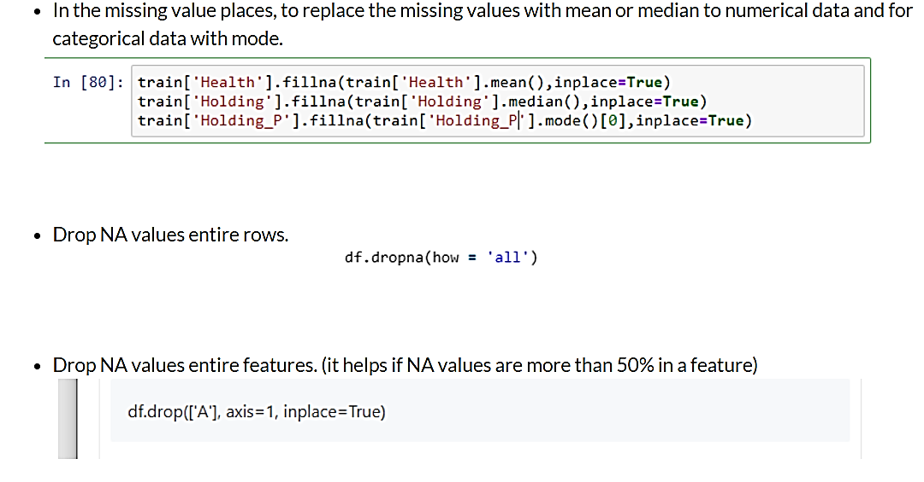
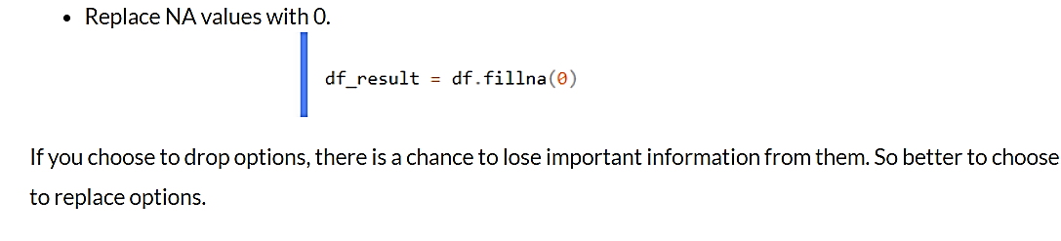

Slide 12
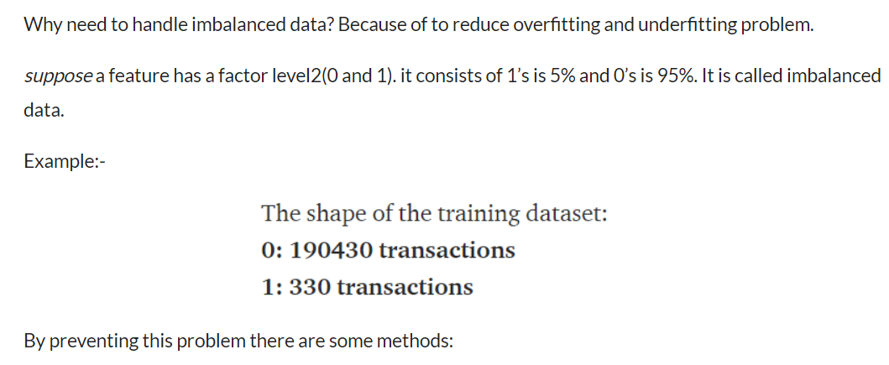
3. Handling imbalanced data
Under-sampling the majority class and Over Sampling Minority class by duplication

Slide 13
Under-sampling the majority class will resample the majority class points in the data to make them equal to the minority class.
Oversampling minority class will resample the minority class points in the data to make them equal to the majority class.

Slide 14
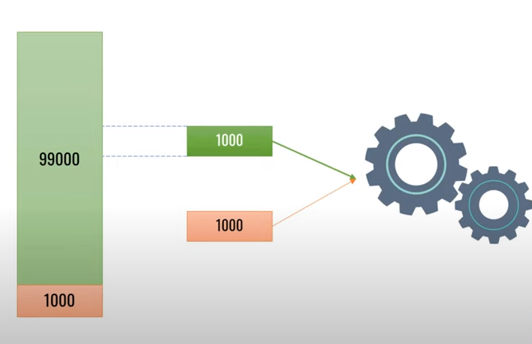
Under-sampling the majority class

Slide 15
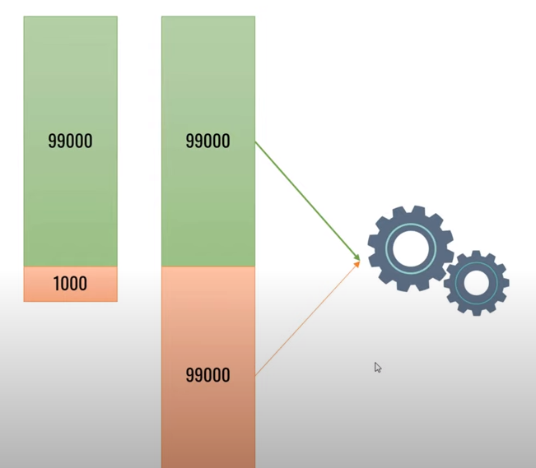
Over-sampling the minority class by duplication
Generate new samples from current samples by just duplicating

Slide 16
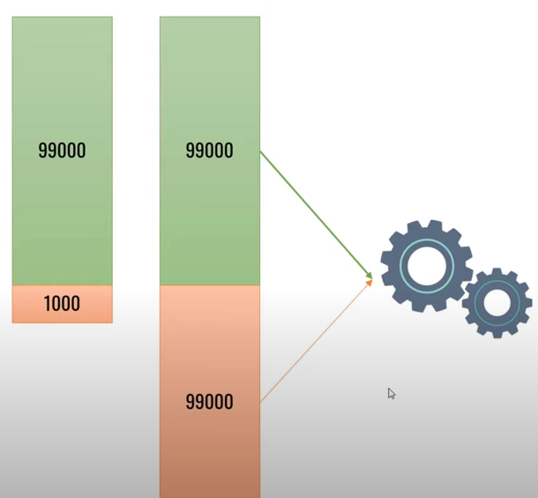
Over sampling minority class using SMOTE
Synthetic Minority Oversampling Technique
Generate synthetic examples using k nearest neighbors algo.

Slide 17
4. Handling outliers
Outliers are those data points that are significantly different from the rest of the dataset. They are often abnormal observations that skew the data distribution, and arise due to inconsistent data entry, or erroneous observations.
Calculating the skewness of the features and check whether they are positively skewed, negatively skewed, or normally skewed. Another method is to plot the boxplot to features and check if any values are out of bounds or not. if there, they are called outliers.

Slide 18
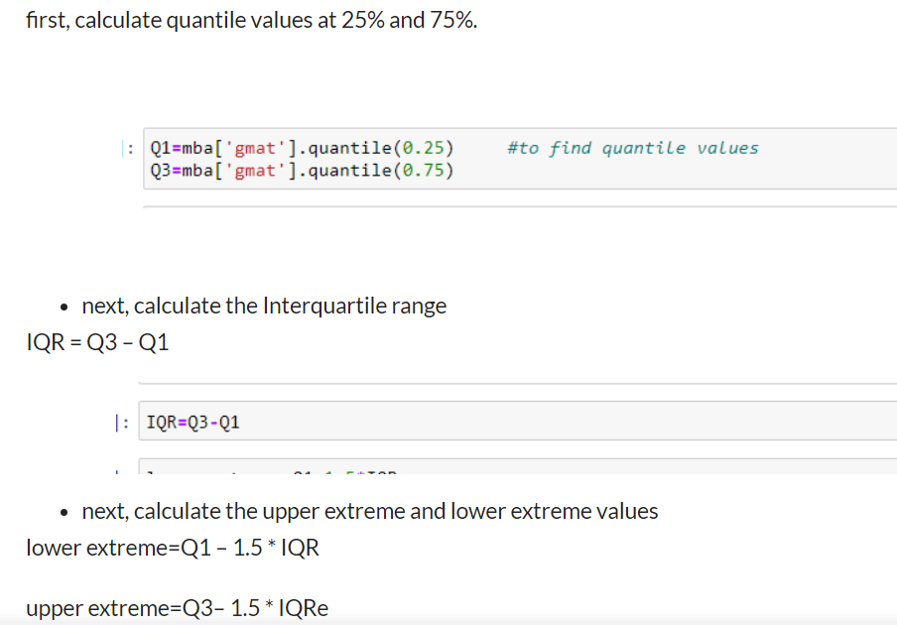
how to handle these outliers: – first, calculate quantile values at 25% and 75%.

Slide 19
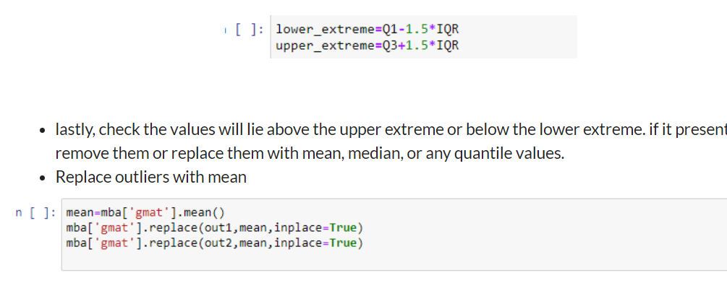

Slide 20
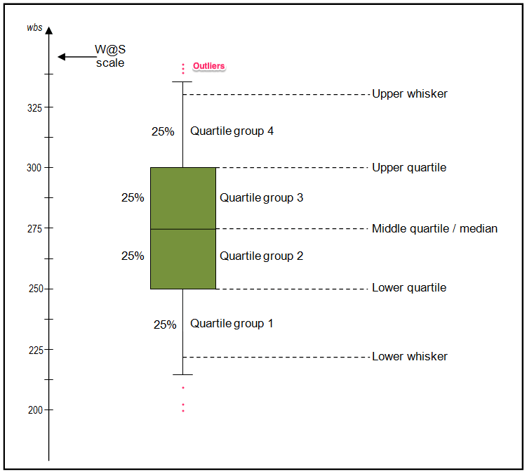
Box plot

Slide 21
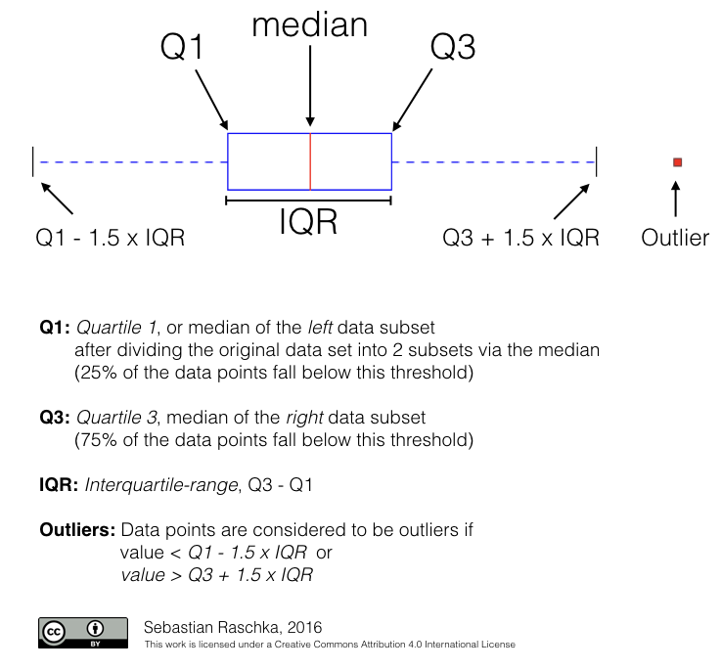

Slide 22
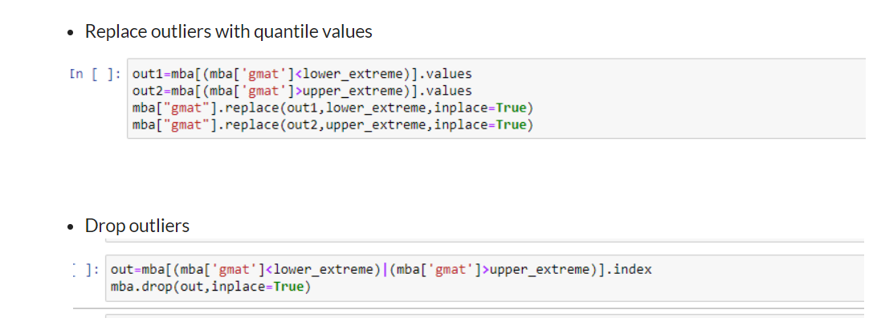

Slide 23
6. Encoding:
Why this will apply? because in datasets we may contain object datatypes. for building a model we need to have all features are in integer datatypes. so, Label Encoder and OneHotEncoder are used to convert object datatype to integer datatype.

Slide 24
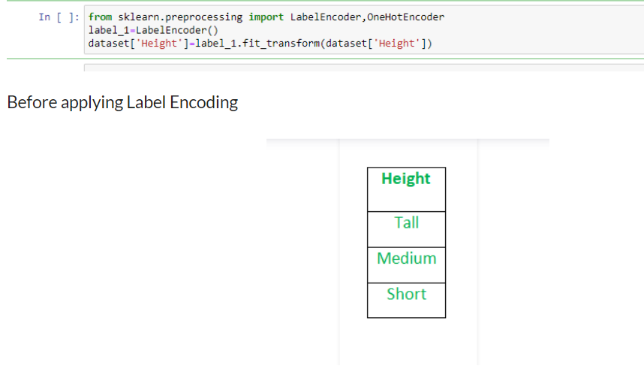
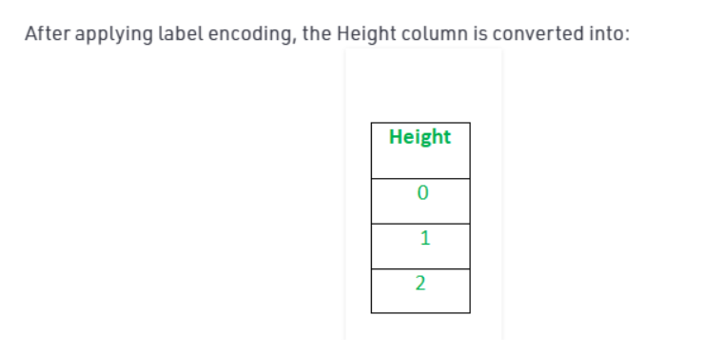

Slide 25
7. Feature scaling
Feature Scaling is a technique to standardize the independent features present in the data in a fixed range. It is performed during the data pre-processing.
Why this scaling is applying? because to reduce the variance effect and to overcome the fitting problem. There are two types of scaling methods:
1) Normalization
2) Standardization

Slide 26
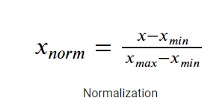
Normalization of data
Normalization also makes the training process less sensitive by the scale of the features. This results in getting better coefficients after training. It scales the values between 0 and 1.

Slide 27
Method of normalization:MinMaxScaler
It is a method to rescales the feature to a hard and fast range of [0,1] by subtracting the minimum value of the feature then dividing by the range.

Slide 28

Standardization
Here all the features will be transformed in such a way that it will have properties of a standard normal distribution with mean 0 and standard deviation 1. It is a technique to standardize the independent features that present in a fixed range to bring all values to the same magn

Slide 29
